Slide 1

SUPERVISED BY:
Dr.Youssef Senousy
PRESENTED BY:
Ahmed Einshouka
Ebrahim Mohamed
Abdelrahman Salah

Slide 2

Table of content
Chapter 1…Introduction
Chapter 2…Literature Survey
Chapter 3…system Analysis
Chapter 4…system design
Chapter 5…Implementation
Chapter 6...Conclusion and Future Work

Slide 3

Overview
The project aims to alleviate the challenges faced by low-budget travelers by providing comprehensive travel assistance, including tour guides, house rentals, car rentals, and camera rentals in various locations.
The objective is to enhance the travel experience for such individuals by offering reliable and affordable solutions to their needs. It consists of four main components: tour guides, house rentals, car rentals, and camera rentals.
Tour guides connect users with local experts who provide insights into destinations, while house rentals offer affordable accommodation options. Car rentals provide competitive rates for exploring destinations, and camera rentals enable capturing memorable moments without high costs.
Overall, the project seeks to empower low-budget travelers, making travel more accessible & enjoyable for all.

Slide 4

Problem Statement
For passionate travelers looking for top-notch adventures without compromising comfort, embarking on budget-friendly travel can be an exciting expedition.
Many adventurers find joy in the exciting quest for perfect travel companions, cozy accommodations, smooth transportation, and necessary gear.
How can one access a world of extraordinary yet budget-friendly travel experiences? By utilizing a comprehensive travel service that serves as a travel genie, turning dreams into actual adventures.

Slide 5

Project Objectives
Empower Low-Budget Travelers: Provide a one-stop platform with tour guides, house rentals, car rentals, and camera rentals, enhancing their trip satisfaction and enjoyment.
Increase Travel Accessibility: Make travel experiences more appealing and accessible to everyone, regardless of budget limitations.
Foster a Thriving Travel Community: Connect travelers and service providers to share knowledge, promote responsible tourism, and enhance freelancing tour guide operations.

Slide 6
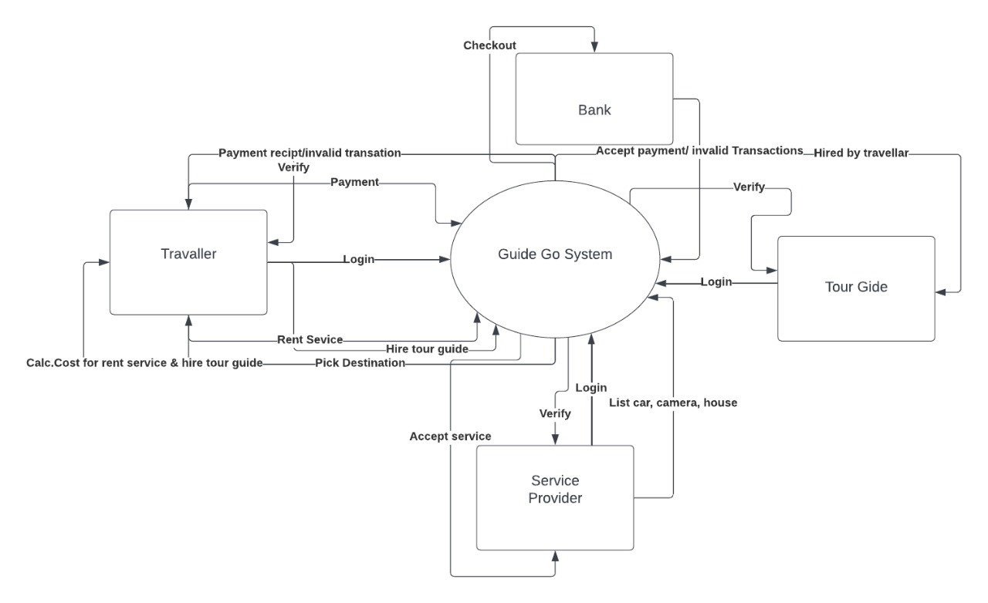
Context Diagram

Slide 7
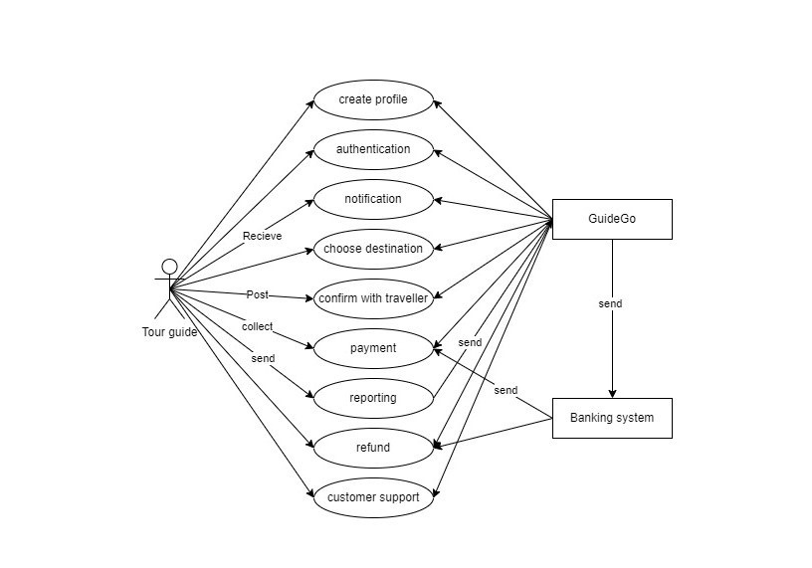
Use Case Diagram

Slide 8
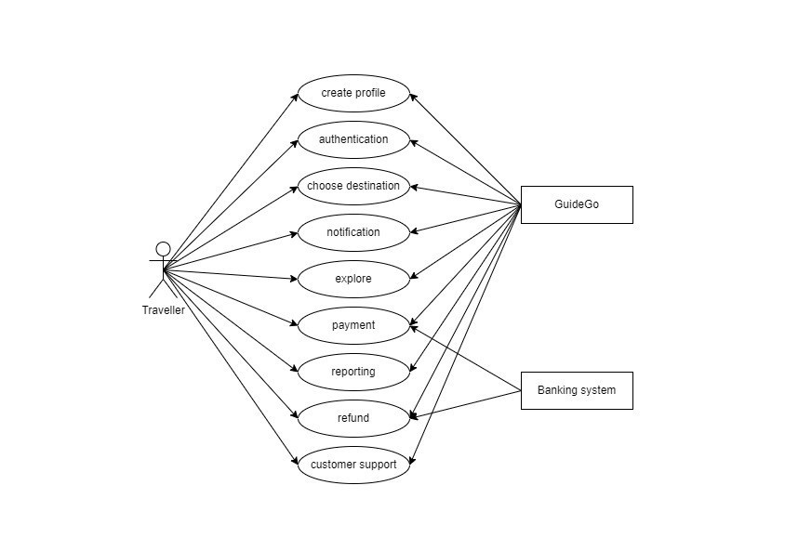
Use Case Diagram

Slide 9
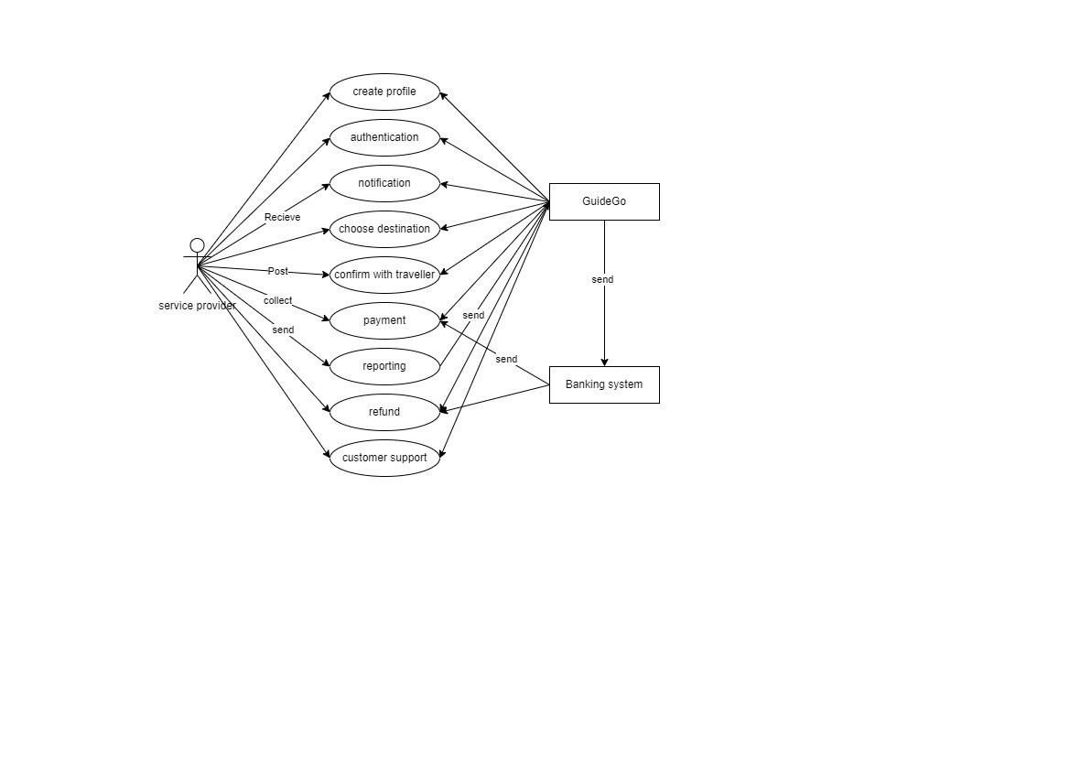
Use Case Diagram

Slide 10
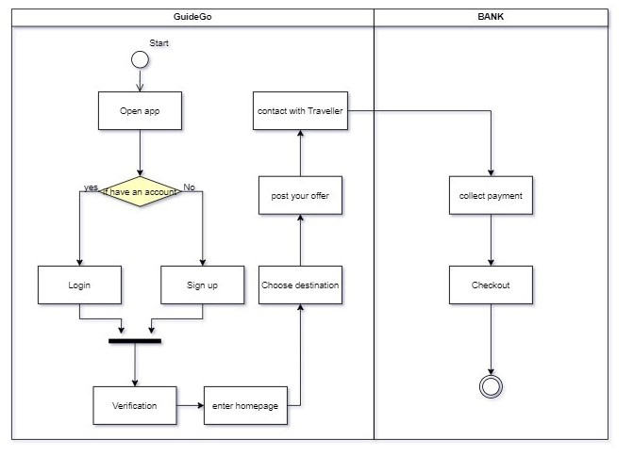
Activity Diagram

Slide 11
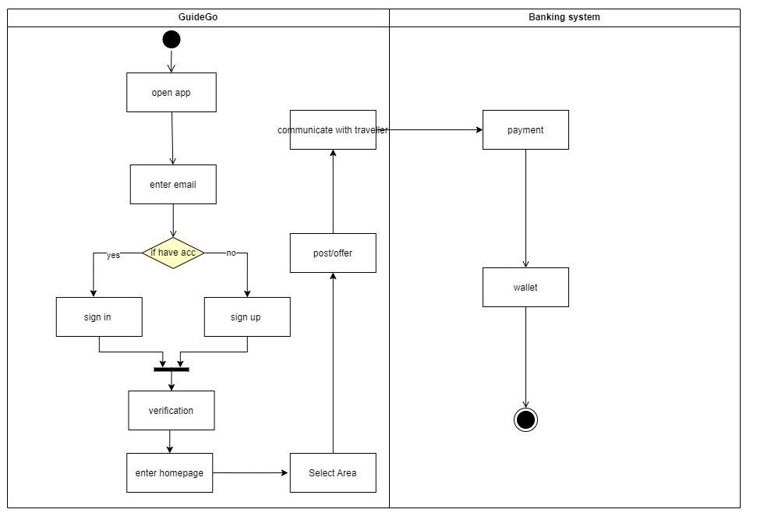
Activity Diagram

Slide 12
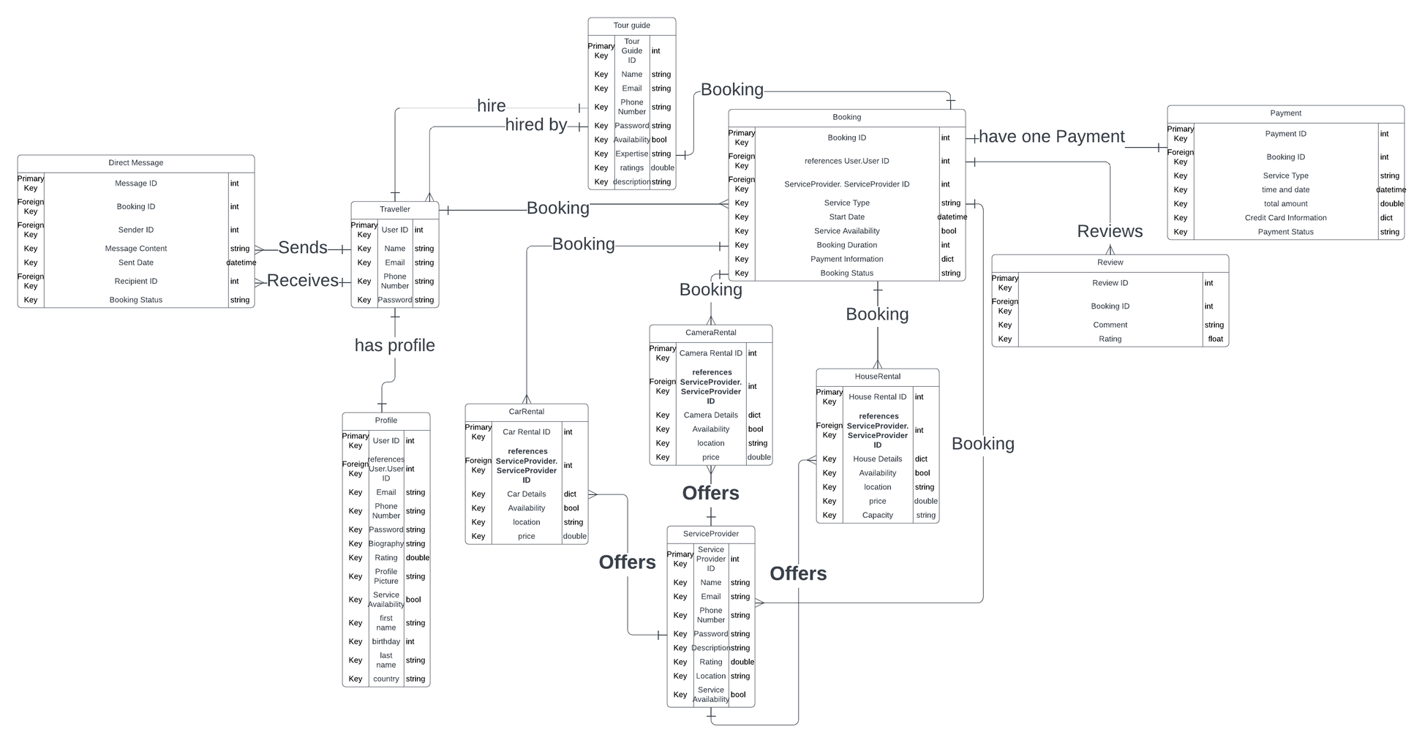
Entity Relationship Diagram ( ERD)

Slide 13
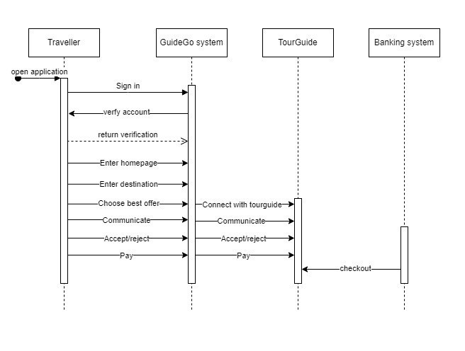
Sequence Diagram

Slide 14
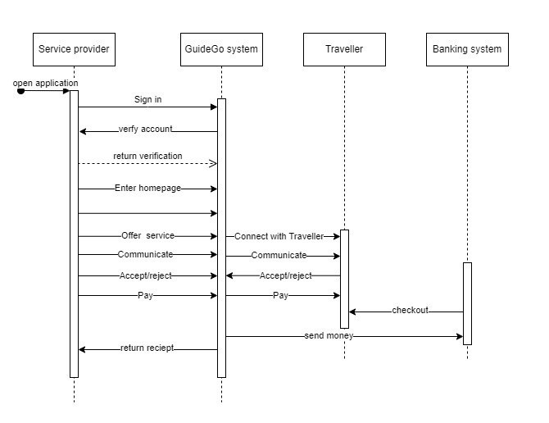
Sequence Diagram

Slide 15
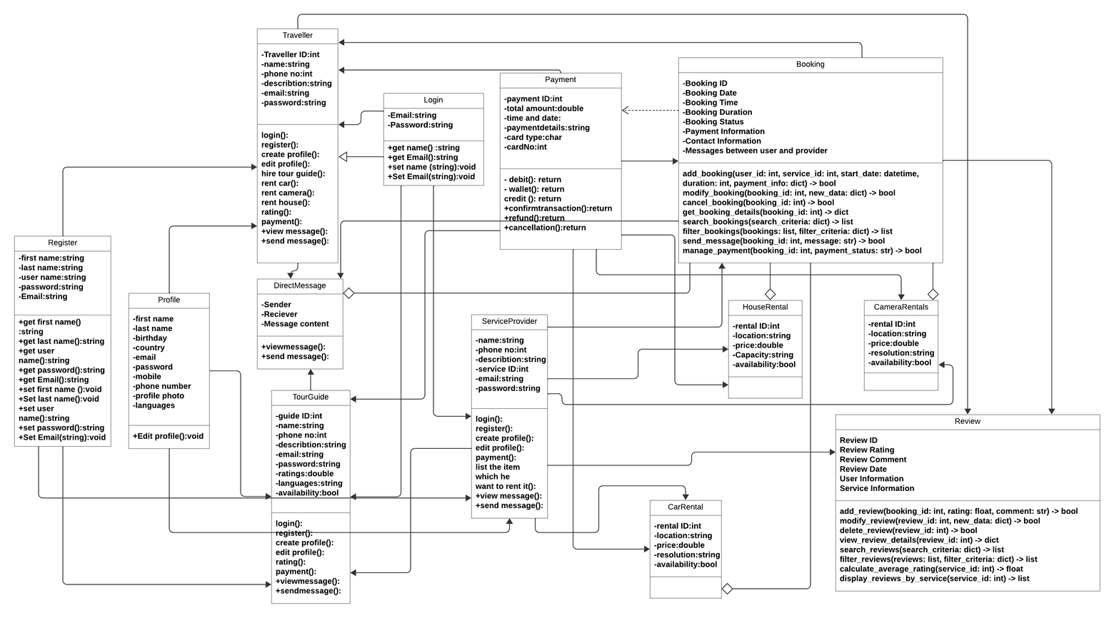
Class Diagram

Slide 16
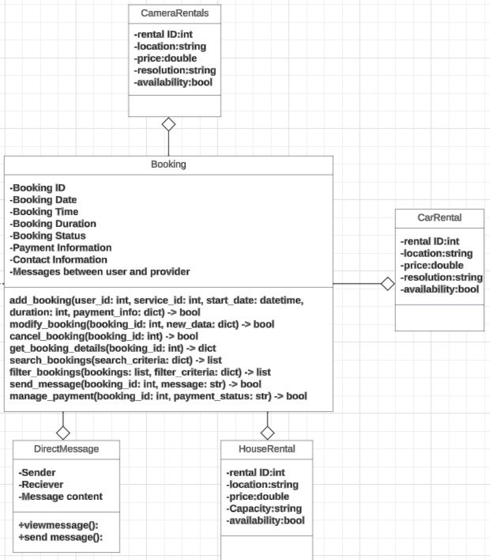
Class Diagram

Slide 17
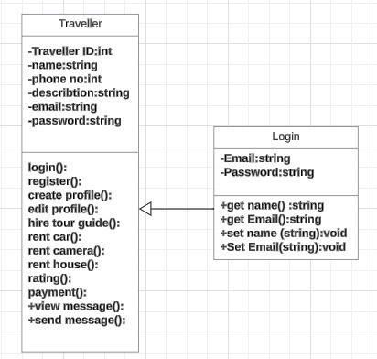
Class Diagram

Slide 18
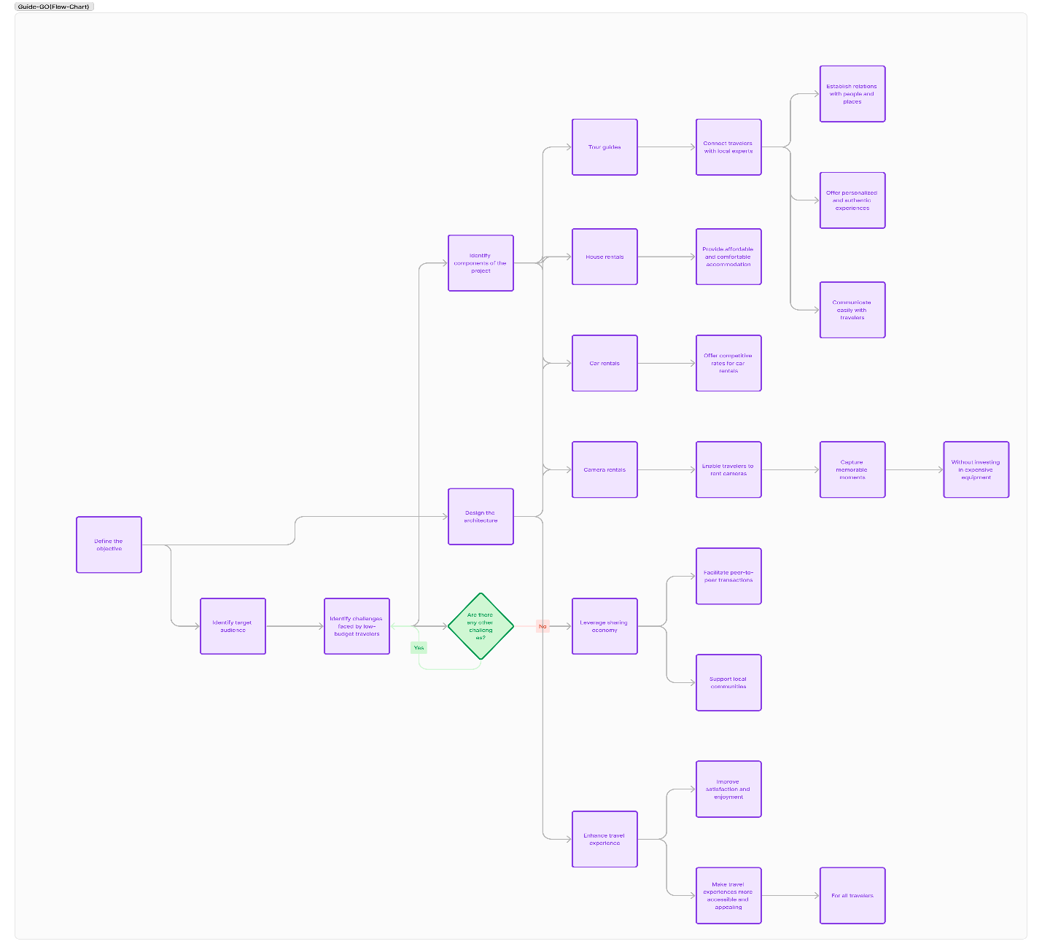
Data Flow Diagram (DFD)

Slide 19
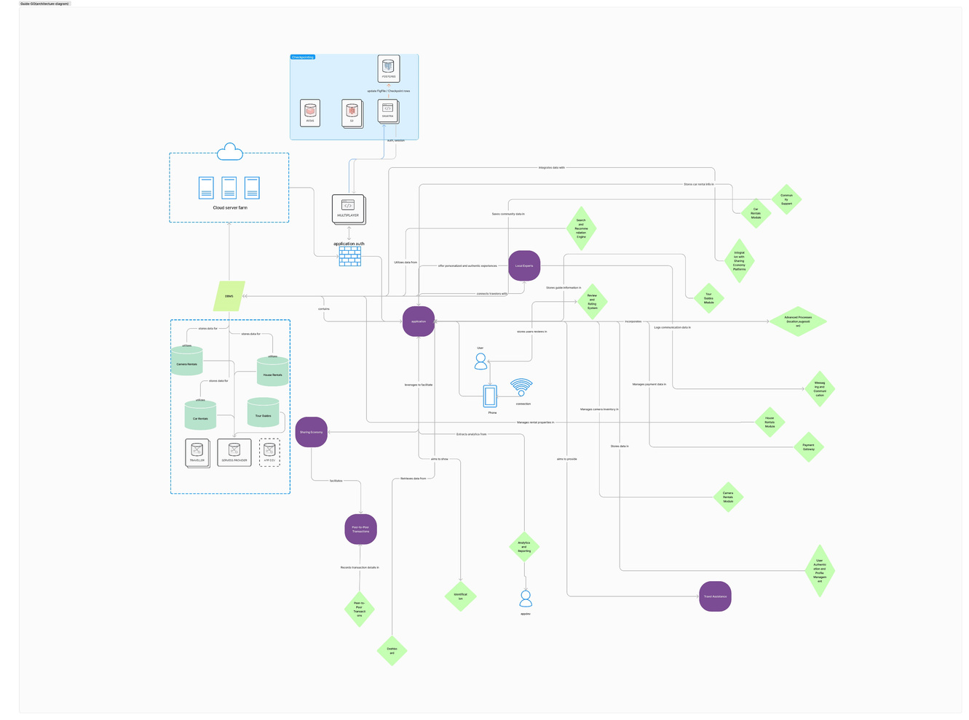
Component Diagram

Slide 20








Tools
Lucid chart
Draw io
Android Studio
Figma
Visual studio code
Flutter
Firebase
GitHub
Appium

Slide 21
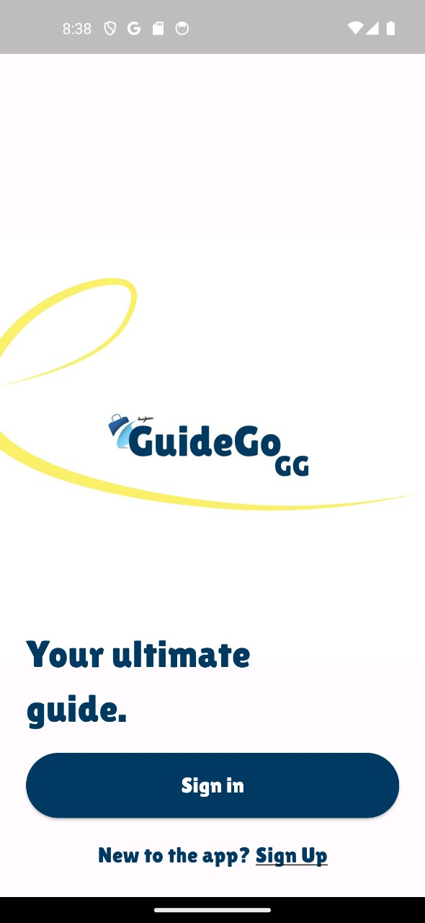
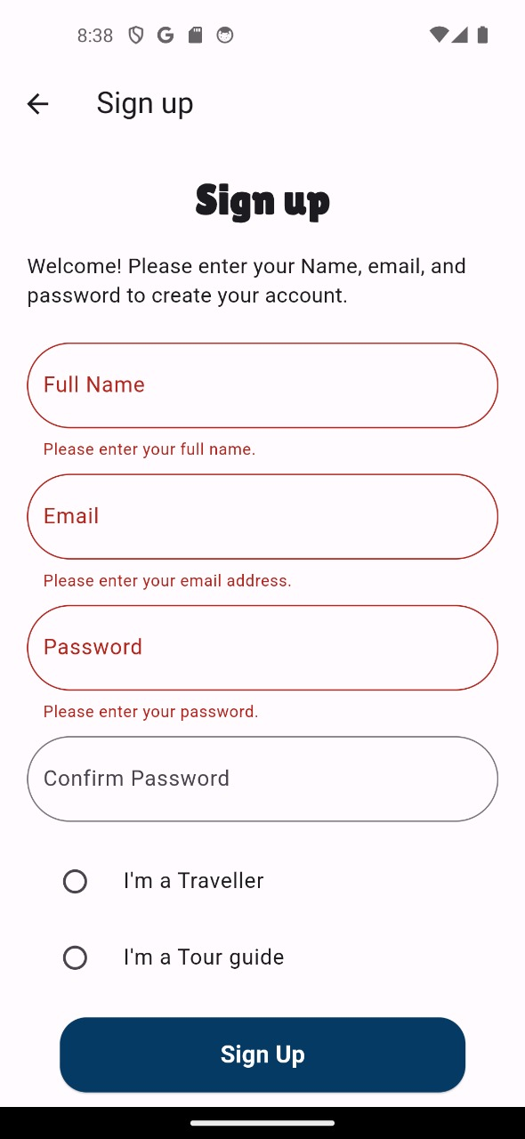
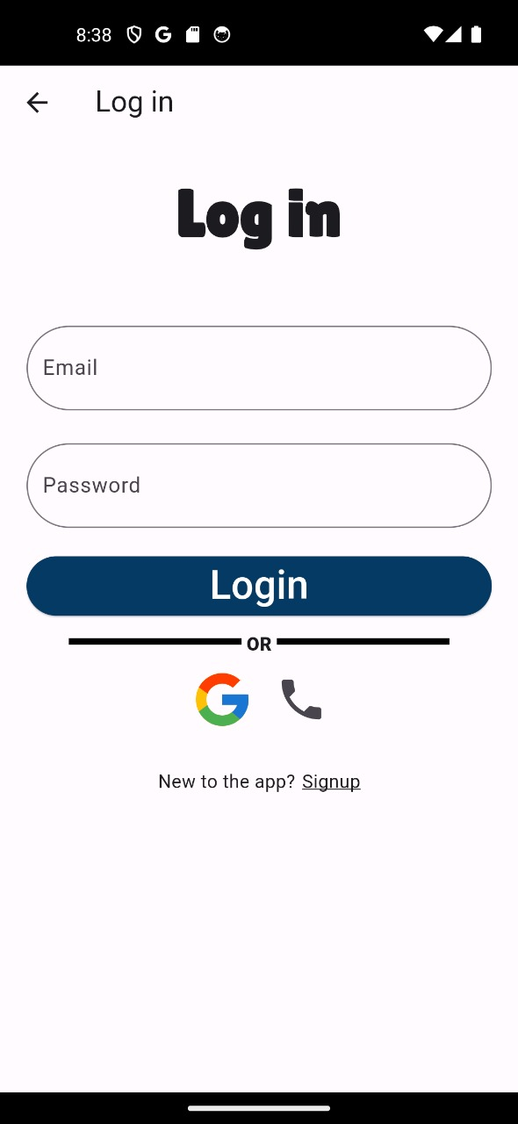
Run screens in Android studio

Slide 22
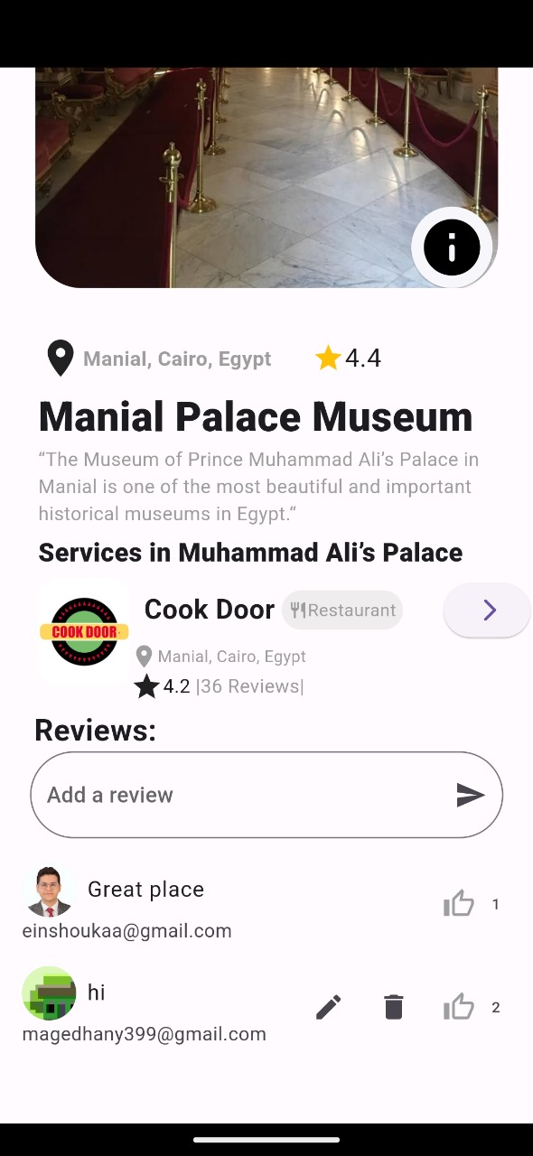
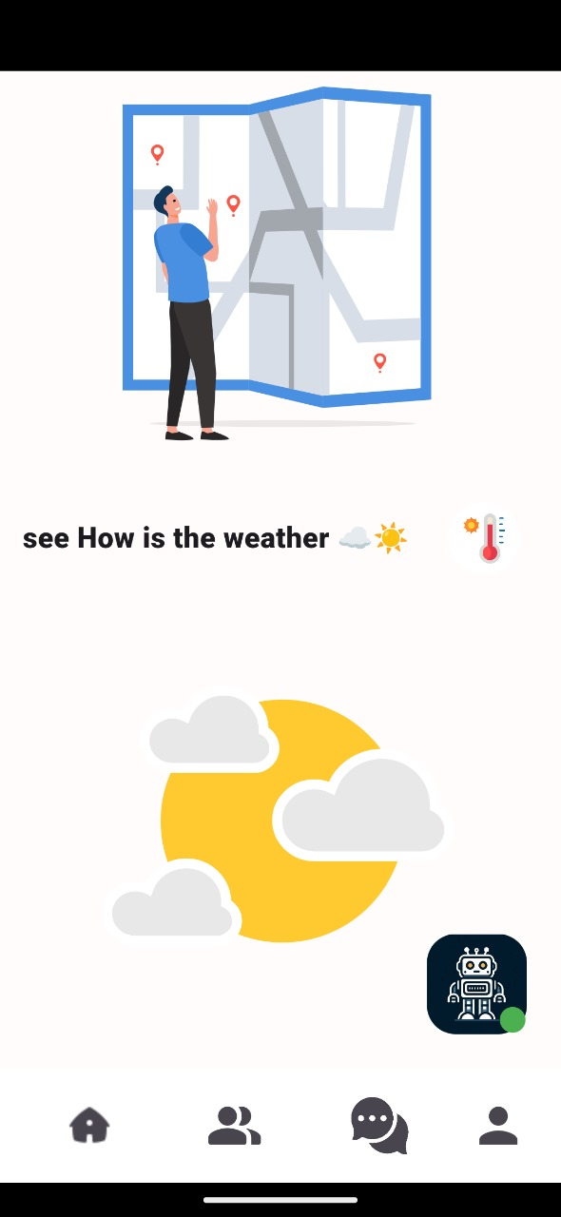

Run screens in Android studio

Slide 23

Future goals
1-User and Guide Profile Management:
Creation and modification of user and tour guide profiles.
Management of tour guide profiles, allowing updates with relevant information.
Property listing features for house, car, and camera owners.
2-Booking Management:
Management of booking requests for guides, houses, cars, and cameras.
Secure payment processing and fund withdrawal options.
Transaction processing system.
Clear policies for booking cancellation and refunds.
3-User Authentication and Security:
Robust authentication mechanisms.
User verification processes.
Customizable privacy settings.
4-Additional Features:
Document scanner feature.
System notifications.
Data analytics tools.
Data backup and recovery measures.
Multi-Language Support interface design.

Slide 24

Conclusion
1-Empowering Low-Budget Travelers:
Providing reliable and affordable travel solutions for enhanced satisfaction.
2-Enhancing Travel Accessibility:
Making travel experiences appealing regardless of budget limitations.
3-Building a Vibrant Travel Community:
Encouraging connections between travelers and service providers.
4-Transforming Low-Budget Travel:
Offering a user-friendly platform for affordable exploration.
5-Bridging Market Gaps:
Meeting the need for reliable and affordable travel services.
6-Making Travel Accessible for Everyone:
Creating a more inclusive and rewarding travel experience.

Slide 25


